Slide 1

Fast Transform
Khoi Phan
Packaged Creator: MikaelSlevinsky, dlfivefifty
, utianyi889

Slide 2
What does Fast Transform do
Fast transform apply some of the concept that we learn in class in order to make the computer run in polynomial time. They apply the concept in Linear Algebra to solve problem such as RoofFinding and Regression. It is apply to the real world computer with less of limit and more optimizing

Slide 3
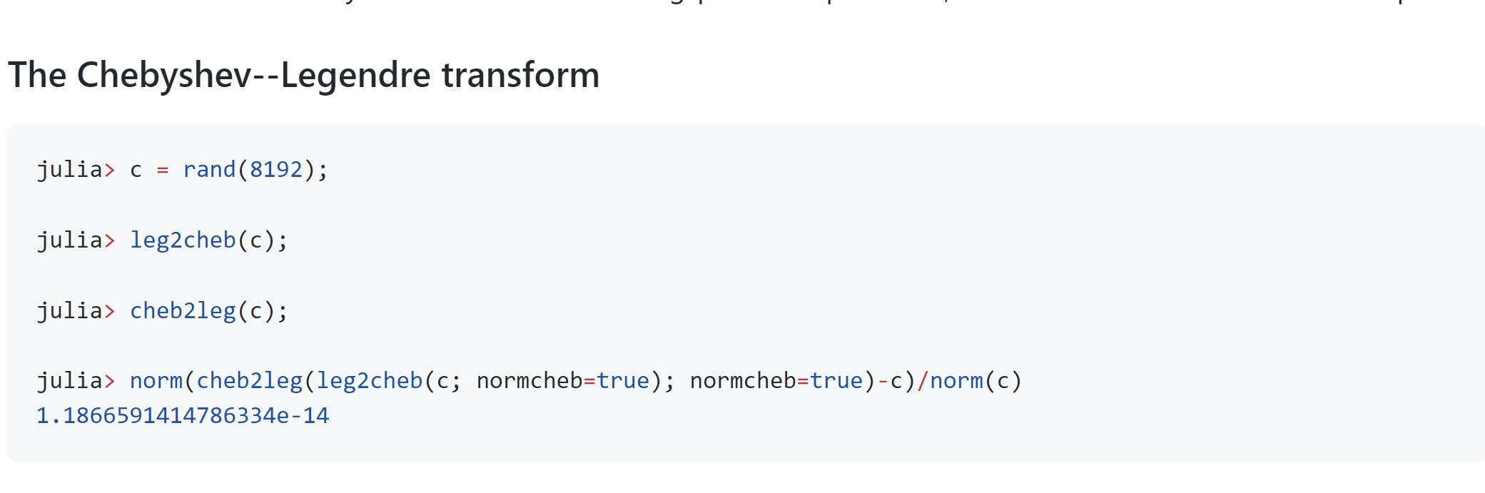
Some Example
So there is some good example about the Fast transform that we can see in the write up
The Chebyshev—Legendre transform which is used in the dynamite and theoretical mechanic in physic which help us save more time in the calculation in the Legendre transform in the formula and perform it better than manual

Slide 4
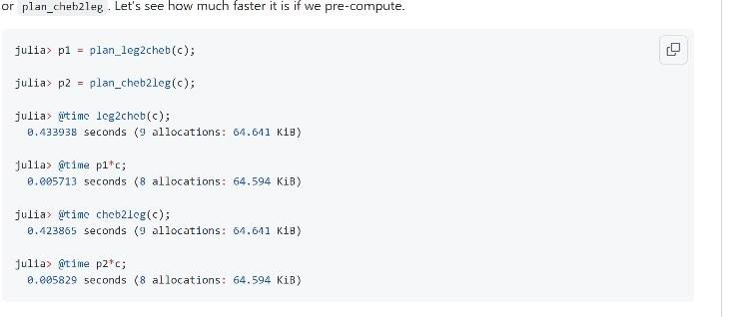
Other example:
This the runtime of the function above which is the function that we pre-compute which we can see that it is faster than we do it manually any run it .

Slide 5
The purpose of this package
It is to help us perform and optimizing the function such as Fast transform, spherical harmonic transform, Nonuniform fast fourier, Padua transform and many other.
It help us as a programmer or a engineer can easy using this kind of difficulty equal and time consuming to either to code it out or write it done by paper. But if we can just use it like an array or a function call then it can be so much faster and time efficiency

Slide 6
How to run the packages
First we need to download Julia to run in our local machine because jupyterhub don’t have engouh
Open Julia
Use “add FastTransform” to down to add the packages
Remember to clone the git FastTransforms
U can use include(“whatever test u want”) to run it

